Slide 1
Murach Ch 11 and 12 HW
Group 8
Calvin Moore, Rajesh Chakka, Ravi Goalla, Varshitha Yataluru

Slide 2
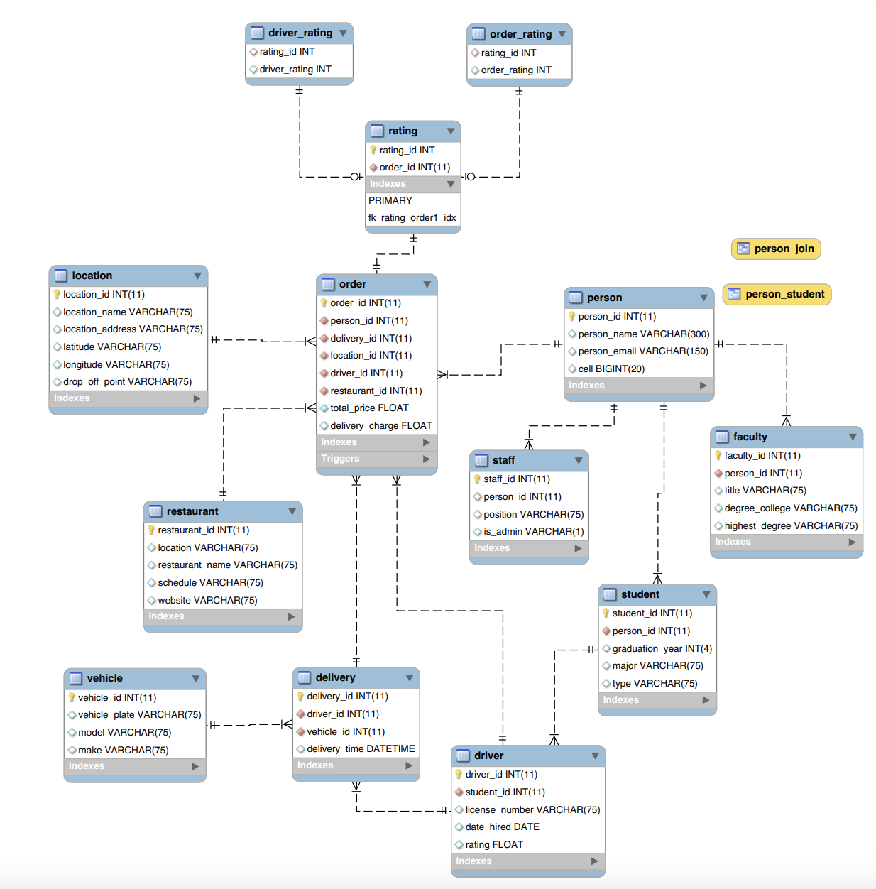
Model

Slide 3
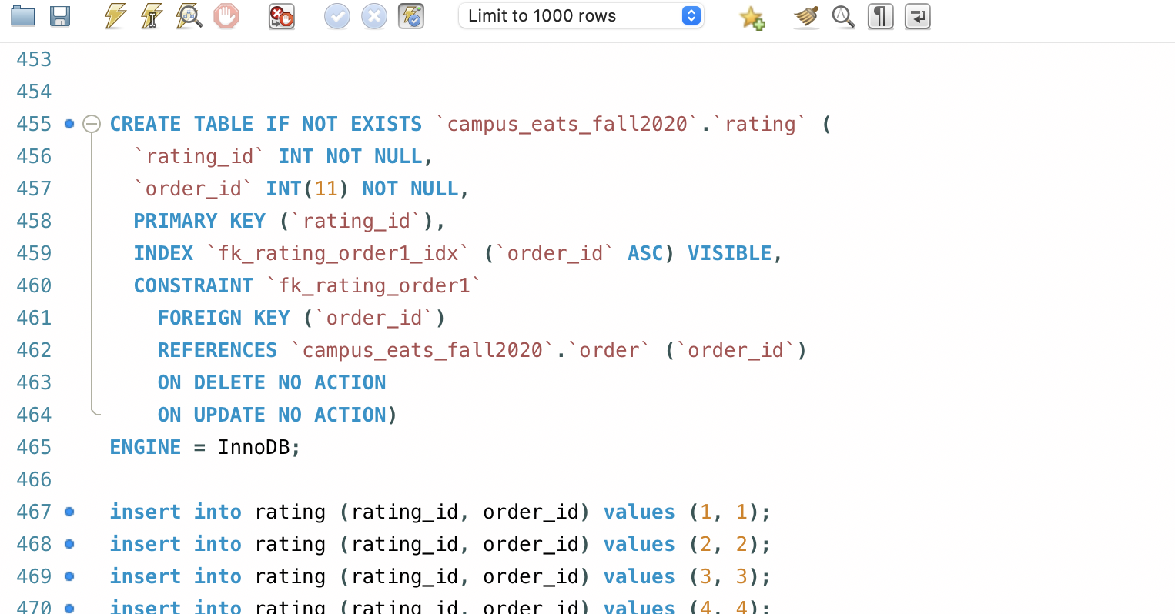
Implementation of Ratings Tables

Slide 4
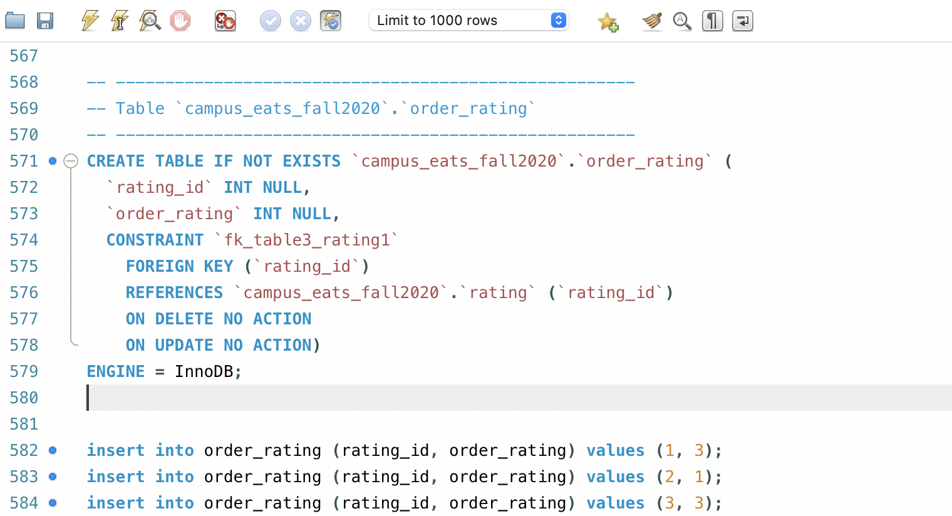
Implementation of Order Ratings

Slide 5
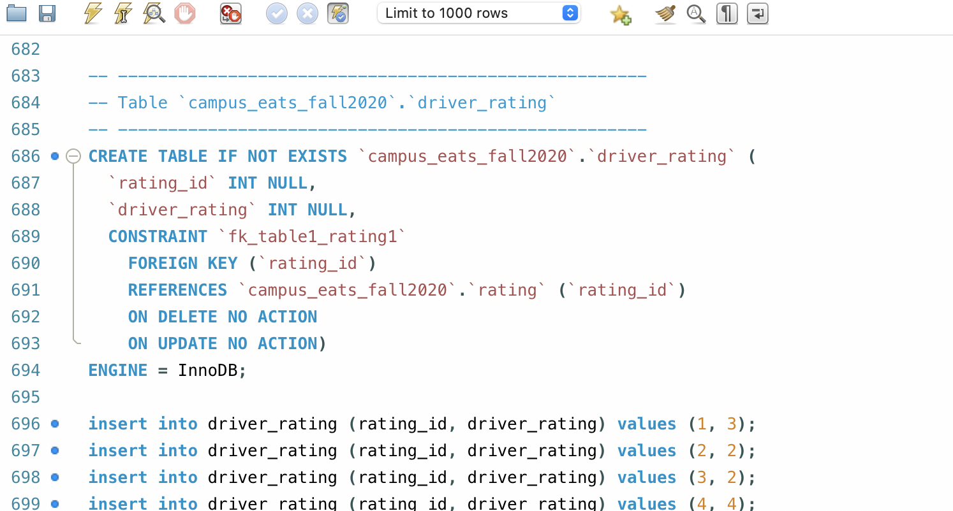
Implementation of Driver Ratings

Slide 6
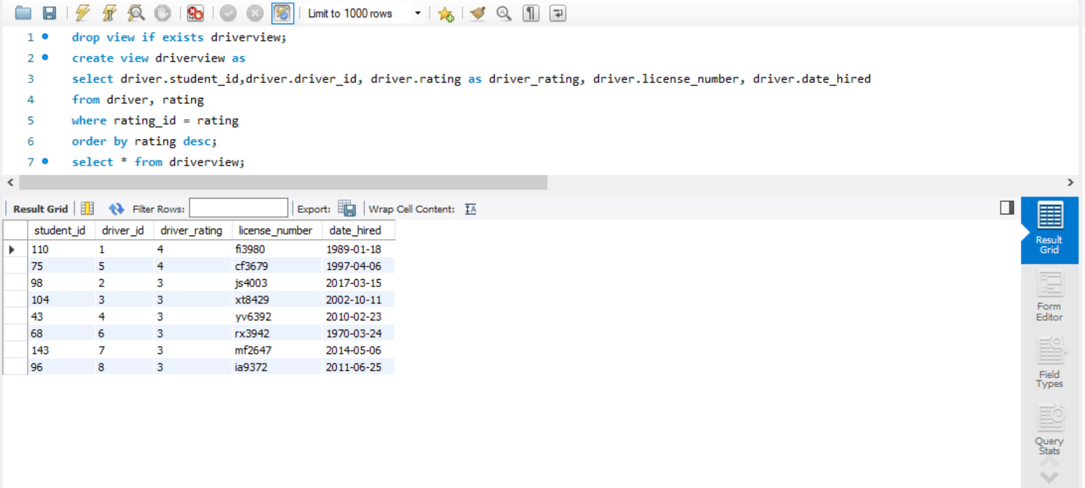
1st View

Slide 7
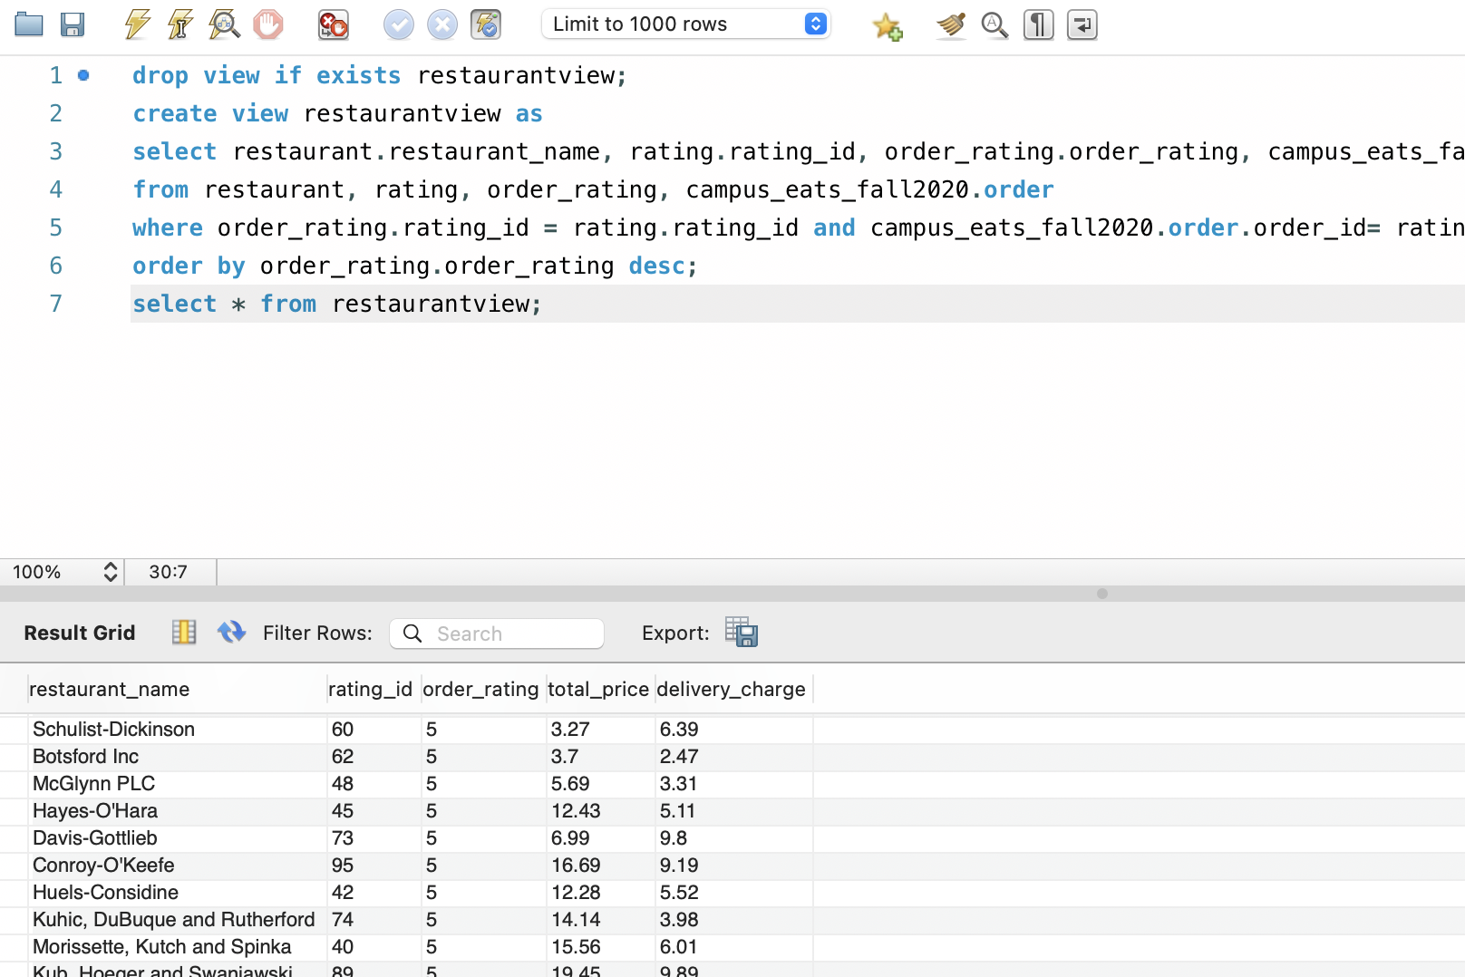
2nd View

Slide 8
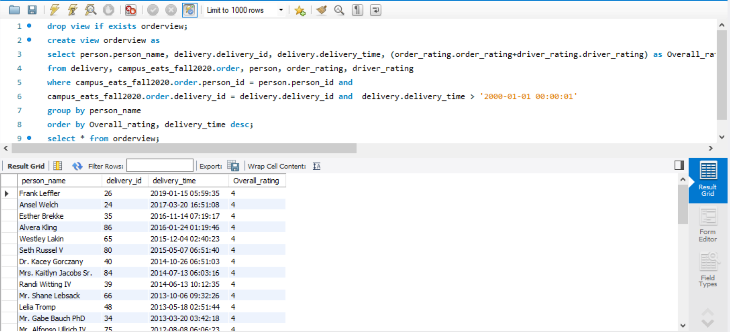
3rd View

Slide 9
Indexes
The indexes in the given database are clustered. Each table in this database has a clustered index.
But, clustered indexes only exist by creation for tables with primary keys. The newly created order_rating and driver_rating tables don’t have a primary key, so they don’t have a clustered index associated with them.
So, we created clustered indexes on rating_id key as it has unique values for order_rating and driver_rating tables.

Slide 10
Corrections Made to Existing Database
Three new tables (rating, driver_rating and order_rating) have been added to the existing database.
The rating table consists of rating_id and order_id, order_id is a foreign key. Rating table has a only one relation with the order table.
Rating table has two subtypes under it, driver_rating and order_rating which have rating_id as a foreign key.
One order can have only one rating and the rating is optional. Each rating_id can be associated with only one order_rating and driver_rating.

